Slide 1
Final Report
Project List:
Amazon sales data analysis
Foreign direct investment analysis
Employee attrition analysis

Slide 2

Tools used:
“Power BI”:
Throughout my internship, I relied on Microsoft Power BI to drive the success of all three projects. Power BI's user-friendly interface and robust features empowered me to craft interactive dashboards that seamlessly integrated data from diverse sources. Its flexibility not only expedited data analysis but also facilitated the delivery of actionable insights, proving instrumental in supporting informed decision-making.

Slide 3
1. Amazon sales data analysis:
Table of content:
Introduction
Dashboard
Dashboard Brief

Slide 4
Introduction:
In response to the organization's need for a comprehensive sales analysis tool, I leveraged Microsoft Power BI to craft an interactive dashboard. By structuring the data and establishing key relationships, I enabled users to seamlessly explore sales trends on yearly, monthly, and yearly-monthly bases. This dashboard not only met but exceeded expectations, providing actionable insights for informed decision-making in the dynamic e-commerce environment.

Slide 5
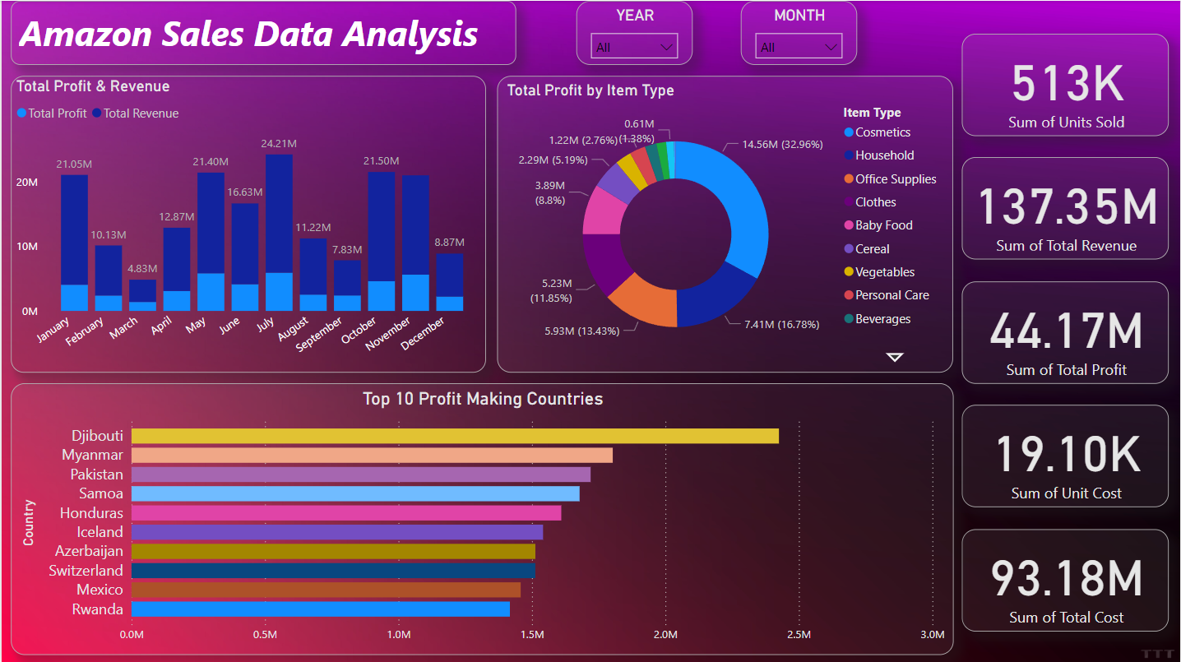

Slide 6
Dashboard Brief:
The above dashboard which I created meet all the criteria to satisfy the problem statement.
The implementation of filters in the dashboard allows the sales trend analysis in all suitable timeframe i.e. Yearly, monthly & yearly-month wise.

Slide 7
2. Foreign Direct Investment Analysis:
Table of content:
Introduction
Dashboard
Dashboard Brief

Slide 8
Introduction:
Tasked with dissecting foreign direct investment (FDI) trends, I meticulously analysed sector-wise and time-wise data. Leveraging Microsoft Power BI, I crafted an intuitive dashboard that seamlessly integrates FDI analysis across sectors and time periods. This dynamic tool provides actionable insights for strategic decision-making, surpassing organizational expectations in delivering comprehensive FDI intelligence.

Slide 9
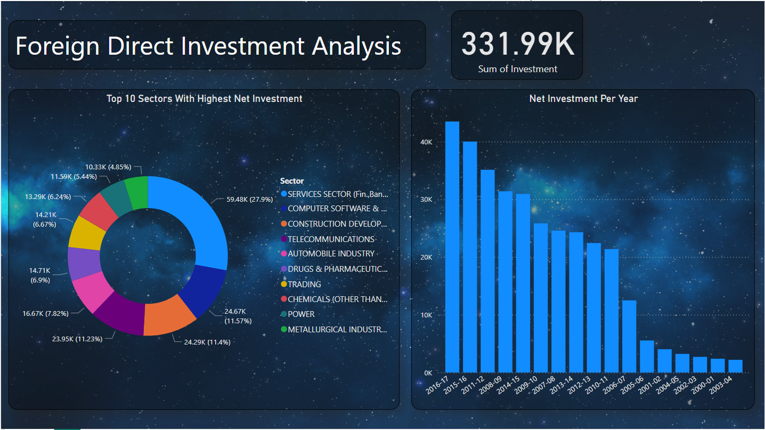

Slide 10
Dashboard Brief:
The above dashboard which I created meet all the criteria to satisfy the problem statement.
I have came up with my own relationship between data and crafted this dashboard, which help to clearly analyse Foreign Direct investment (FDI) trends with time factor and the sectors factor.

Slide 11
3. Employee Attrition Analysis:
Table of content:
Introduction
Dashboard
Dashboard Brief

Slide 12
Introduction:
I conducted a focused analysis to identify the primary factors driving employee attrition. Utilizing various data points such as demographics and job satisfaction levels, I uncovered patterns and correlations. Leveraging Microsoft Power BI, I created a succinct dashboard that provides actionable insights to address attrition challenges and foster a more engaged workforce.

Slide 13
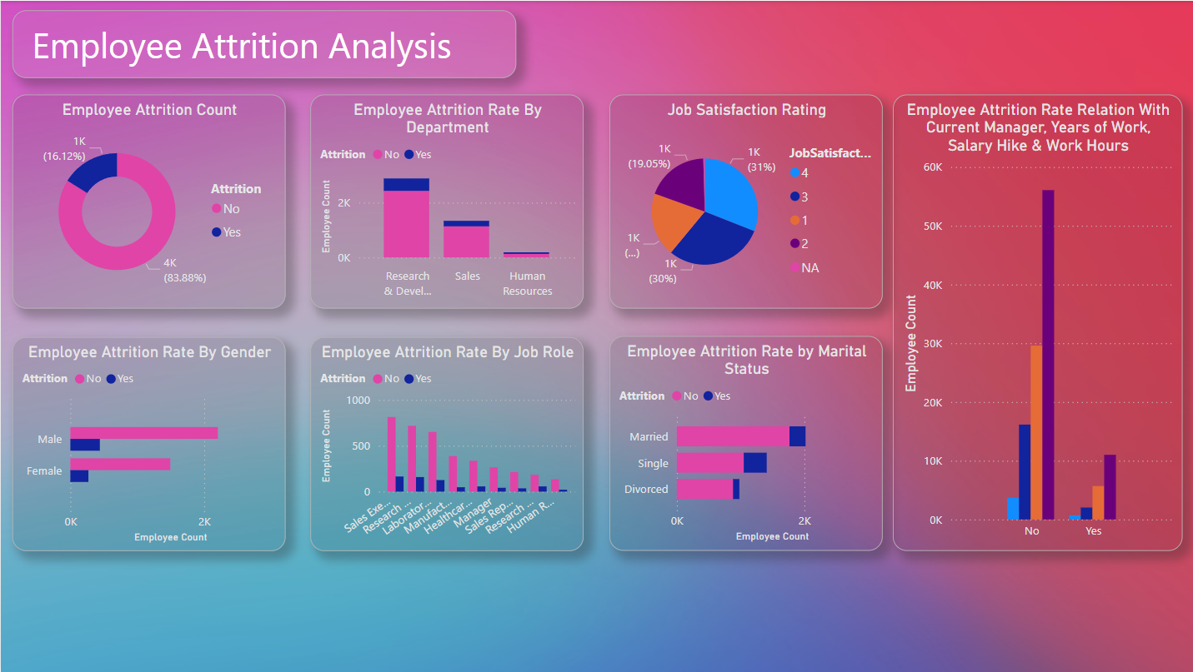

Slide 14
Dashboard Brief:
The above dashboard which I created meet all the criteria to satisfy the problem statement.
I have came up with my own relationship between data which help to analyse the key factors that may lead to employee attrition.
Employee attrition is a key factor of an organization. my dashboard helps for the analysis of the factors causing it and the relation that may help out more for further analysis.

Slide 15
Thak You!
- Harish Pudake

